Slide 1
Zomato Food Order Analysis
Presented by:
Borra Vasavi
Hasmitha D K

Slide 2
INTRODUCTION
Understanding Customer Preferences: Analyzing Zomato's food order data helps identify customer preferences, popular cuisines, and ordering patterns.
Performance Metrics: It evaluates delivery efficiency, average delivery time, and customer satisfaction to enhance service quality.
Revenue Insights: The analysis provides insights into revenue distribution across locations, customer segments, and timeframes.
Trend Prediction: By studying historical data, it aids in predicting future food trends, peak ordering times, and demand surges.
Business Optimization: The findings enable Zomato to improve restaurant recommendations, pricing strategies, and marketing campaigns.

Slide 3

OBJECTIVES
Identify Popular Choices: To determine the most ordered dishes, cuisines, and restaurants, helping cater to customer preferences effectively.
Improve Operational Efficiency: Analyze delivery times and delays to optimize logistics and enhance the customer experience.
Enhance Revenue Generation: Understand revenue patterns to identify high-performing areas, peak order times, and pricing strategies.
Monitor Customer Behavior: Study ordering habits, frequency, and spending to develop personalized marketing campaigns.
Support Strategic Decision-Making: Provide data-driven insights to guide Zomato’s partnerships, menu updates, and service expansions.

Slide 4
METHODOLOGY
Data Collection: Gather historical data from Zomato, including order details, customer demographics, delivery times, restaurant ratings, and payment methods.
Data Preprocessing: Clean and preprocess the data by handling missing values, duplicates, and outliers, and standardizing formats for analysis.
Exploratory Data Analysis (EDA): Use visualization and statistical techniques to explore patterns, trends, and relationships within the dataset.
Analysis Techniques: Apply clustering, regression, or classification methods to segment customers, predict demand, or identify key factors affecting orders.
Insights and Reporting: Summarize findings in reports or dashboards, using tools like Excel, Power BI, or Tableau for visualization, to communicate actionable insights.

Slide 5
TOOLS AND TECHNOLOGIES
Programming Language: Python ( for Data Cleaning , Analysis)
Libraries: Pandas, NumPy, Matplotlib, Seaborn, Plotly
Integrated Development Environments (IDEs): Jupyter Notebook
Data Source: Kaggle dataset ( Zomato Food Order Analysis )
Database: MySQL ( for Structured Data Storage and Management )

Slide 6
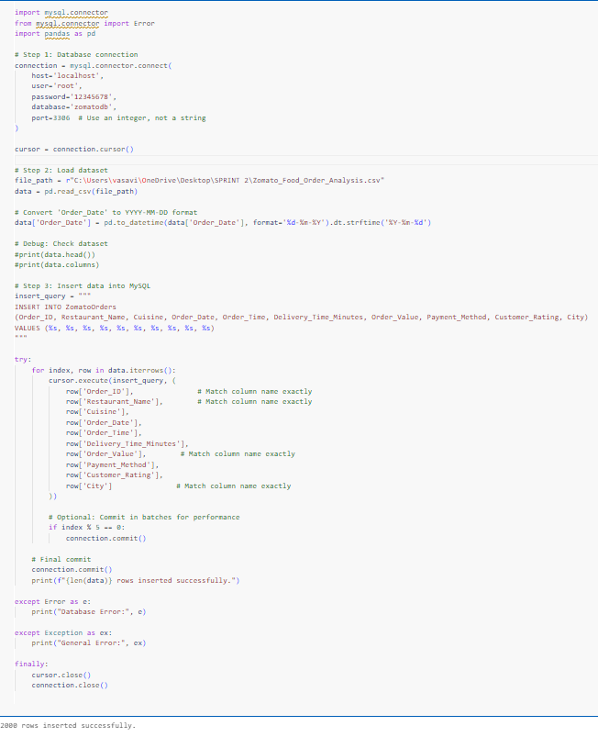
DATABASE CONNECTIVITY
There is a connection object that connects to the MySQL database and is used to insert data from a CSV file into the database via SQL queries in Python Script itself.
It is necessary to specify the host, user, password, database name and port number.

Slide 7
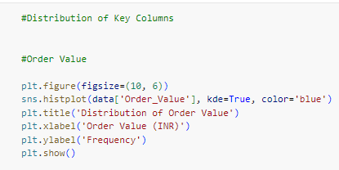
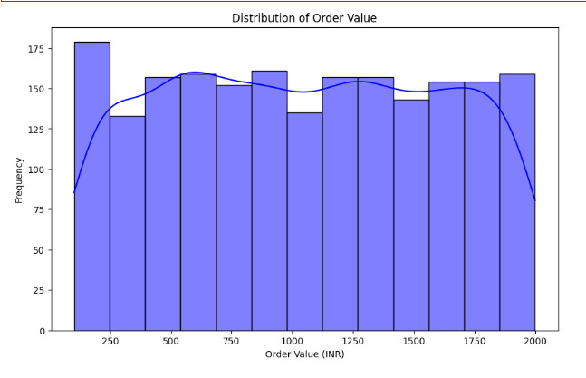
Data Analysis

Slide 8
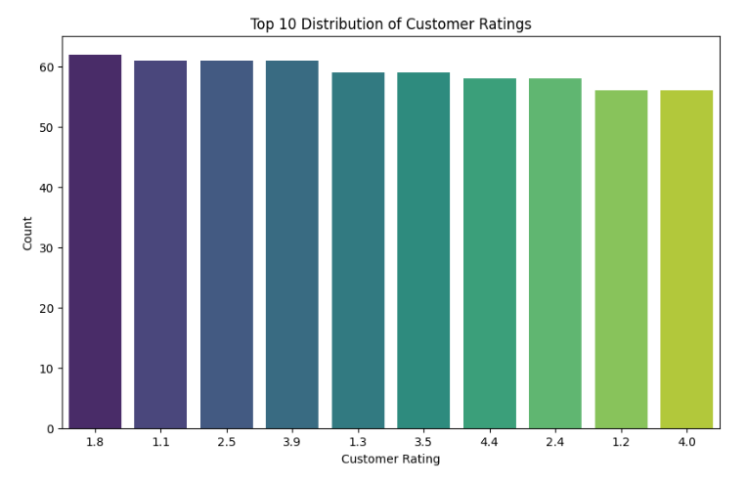
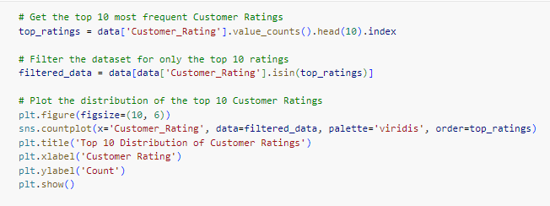
Data Analysis

Slide 9
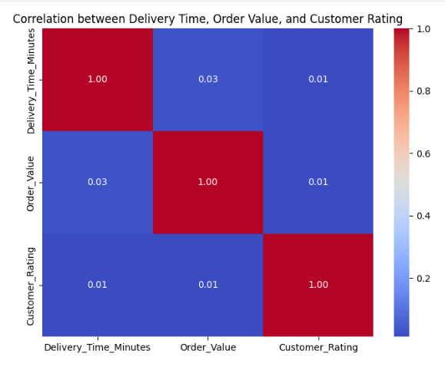
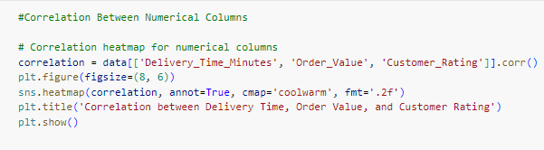
Data Analysis

Slide 10
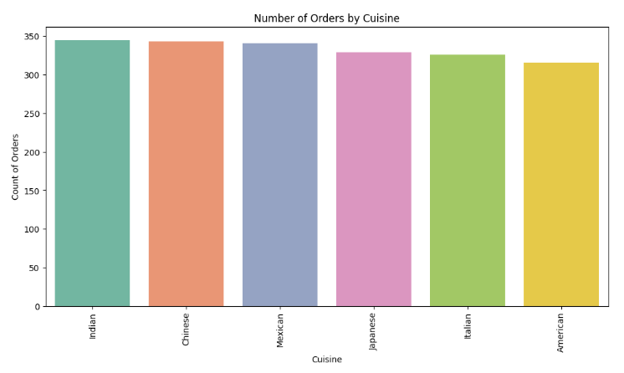
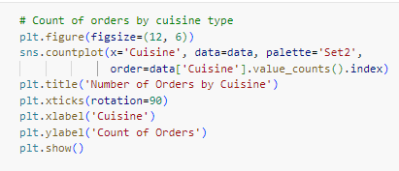
Data Analysis

Slide 11
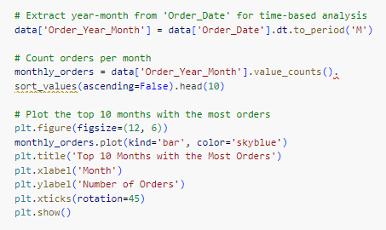
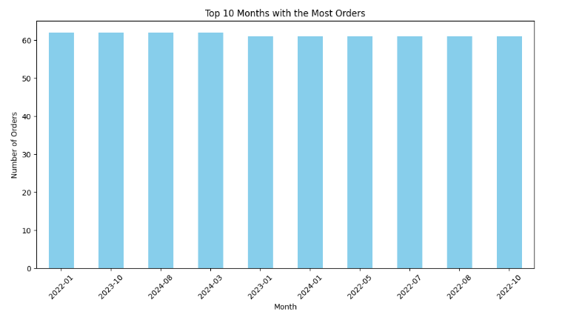
Data Analysis

Slide 12
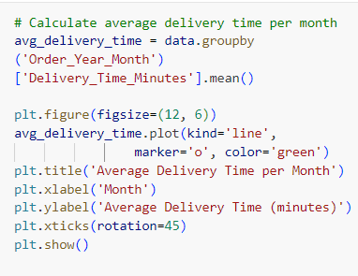
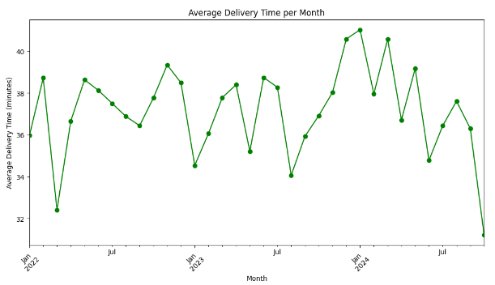
Data Analysis

Slide 13
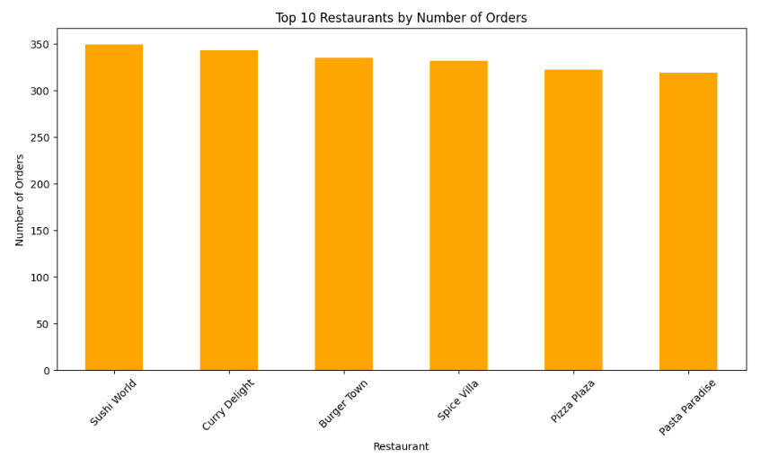
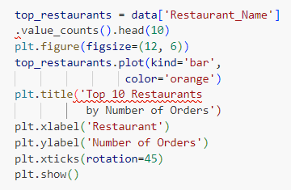
Data Analysis

Slide 14
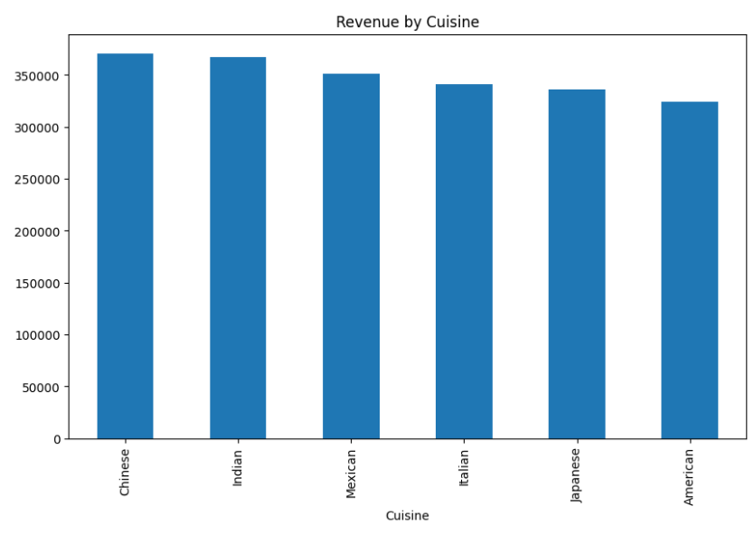
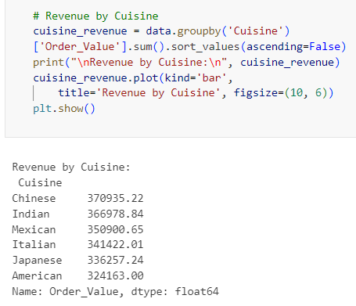
Data Analysis

Slide 15
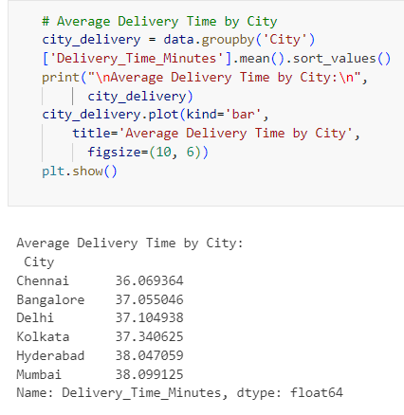
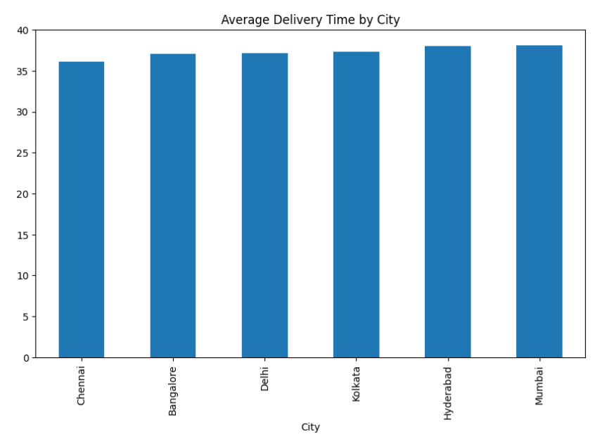
Data Analysis

Slide 16
CONCLUSION
This project aims to reveals key insights into order trends, revenue generation, and delivery efficiency across various cities and cuisines. The data highlights which restaurants and cuisines are most popular, as well as variations in delivery times by city. Such analysis helps identify performance patterns and areas for improvement in customer experience, providing valuable information for optimizing operations and marketing strategies.

Slide 17


